Slide 1
CloudBees Jenkins

Slide 2
CloudBees Jenkins Platform Workflow with Docker

Slide 3
Agenda (Day 1)
The Need For Workflow
What Is Workflow?
Workflow Use Cases
Workflow Structure and Syntax
Key Workflow DSL
Git
Sh
Step
Node

Slide 4
Agenda (Day 2)
Key Workflow DSL
Input
Parallel Execution
Stages
Checkpoint
Execution Control
If else
For loops
waitUntil
Sleep
Retry
Timeout
While

Slide 5
Agenda (Day 3)
Review Workflow Concepts
Complete Workflow Exercise

Slide 6
Agenda (Day 4)
Docker
Integrating Workflow and Docker
Course Review

Slide 7
Workflow with Docker Day 1

Slide 8
The Need For Workflow

Slide 9
**Need Slides: Need for Workflow

Slide 10
What is Workflow?

Slide 11
What is Jenkins Workflow
CD is about setting a “pipeline”, from SCM commit to deployed application
Jenkins can chain jobs this way, but ...
Build
Test
Deploy

Slide 12
Jenkins CD pipeline
a real world CD pipeline is way more complex !
requires (complex) conditional logic
requires resources allocation and cleanup
involves human interaction for manual approval
should be resumable at some point on failure

Slide 13
Jenkins CD pipeline
many related plugins
conditional build steps
parameterized trigger
promotions
...
Major issue : pipeline configuration is scattered in various jobs

Slide 14
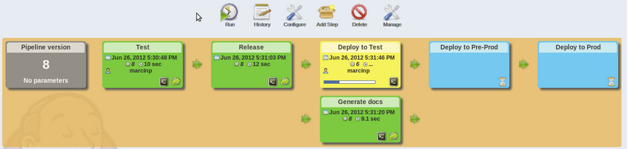
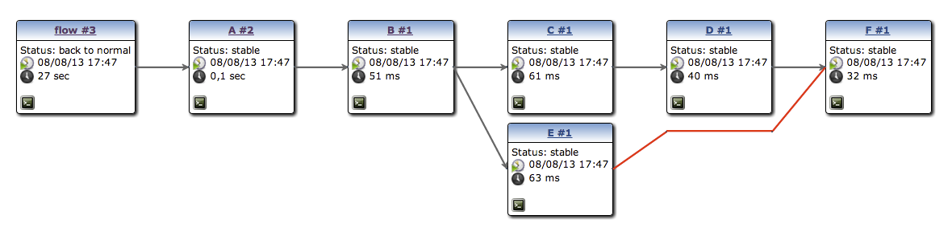
CD pipeline visualization
pipeline plugin to render “linear” pipeline
build-graph-view to render complex ones

Slide 15
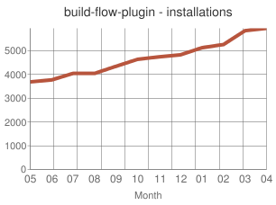
build-flow plugin
OSS, considered a proof of concept
define CD pipeline as (possibly complex) job orchestration written with a Groovy DSL
largely adopted
demonstrates direction is correct
But major technical limitations

Slide 16
CloudBees Workflow Plugin
inspired by build-flow
Groovy DSL to orchestrate build steps (optionally jobs)
extensible DSL syntax
do supports checkpoints
advanced visualization
plain text : Can be stored in SCM
Notes:
Visiualization is available only in the enterprise edition, no Team (opensource).
Also enterprise only is Check.points

Slide 17
Workflow Use Cases

Slide 18
Groovy DSL ?
Groovy based “Domain Specific Language” to manage build step orchestration
Groovy is widely used in Jenkins ecosystem. You can leverage on Groovy experience
If you don’t like/care about Groovy, just consider the DSL as a dedicated simple syntax
Notes:
Need to have very little Groovy knowledge. Just be able to identify and coopy/past code snippets etc.
Lots of flex, little coding needed. Can also store you code and workflow esigns

Slide 19
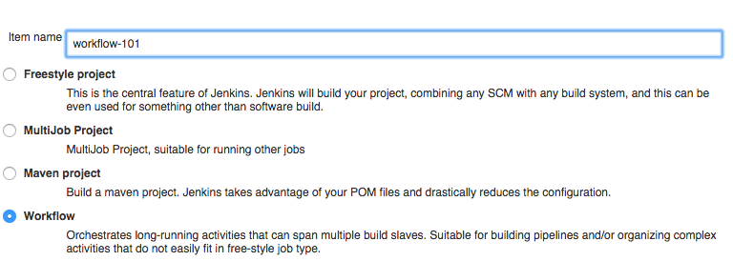
Workflow 101
a Workflow is a new type of job
Notes:
Step 1 – create new workflopw

Slide 20
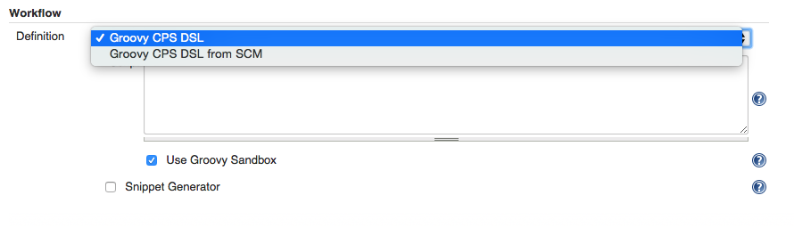
Workflow 101
Can define DSL in jenkins, or store in SCM
=> possibly distinct workflow per branch
no need to be an administrator
no need to know groovy or DSL syntax
Notes:
SCM = source control manager
Tick Snippet Generator to limit need for Groovy.

Slide 21
Workflow Structure and Syntax

Slide 22
Workflow 101 - basic DSL syntax
DSL is used to define when/how to run build steps
those (most of them) will run on a node, i.e. a build executor
node('slave') { sh 'echo hello world' }
DSL keyword to run a shell script build step
Notes:
“node” doesn’t exist in Groovy – it is a DSL

Slide 23
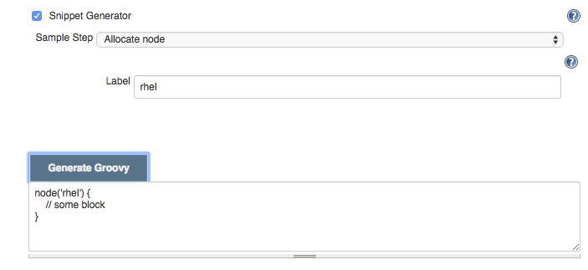
Workflow Snippet Generator
No need to learn DSL syntax !
Notes:
First line odf groovy script.
Using Groovey sandbox and this snippet generator makes this as easy as ppossible.

Slide 24
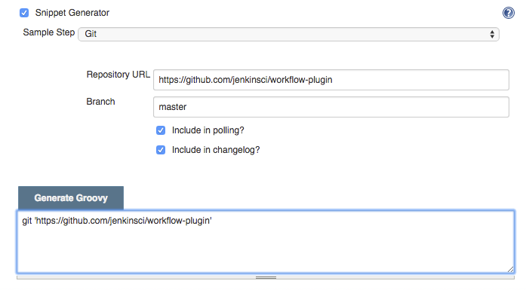
Workflow 101 - build steps
Some have native DSL support
Notes:
Snippet wiz creates the groovy for you

Slide 25
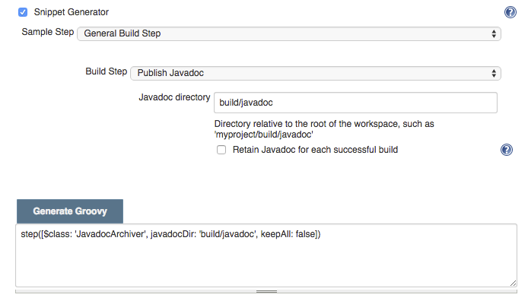
Workflow 101 - build steps
Some don’t (yet) have native DSL support and require some hack-ish invocation syntax - but still work

Slide 26
invocation syntax
step(
[
$class: 'build_step_class_name',
constructor_argument: 'value',
constructor_argument_2: 'value'
]
)
Most build steps can be used this way today, they may evolve to offer native workflow support
DSL keyword to invoke arbitrary step
Same as in job’s config.xml on disk
groovy map

Slide 27
Lab Exercise:
DSL Syntax

Slide 28
Lab 1 – DSL syntax
Goal:
The aim of this initial Lab is to
get familiar with Workflow plugin
and DSL syntax basis.
See Lab Exercise Workbook
Lab 1.
“Hello World”

Slide 29
Key Workflow DSL – git

Slide 30
Lab 2 – git
Goal:
The aim of this Lab is to use git
to reach out to the SCM.
See Lab Exercise Workbook
Lab 1.
Interact with SCM

Slide 31
Key Workflow DSL – sh

Slide 32
Lab 3 – sh
Goal:
The aim of this Lab is to
introduce the use of a shell
script in Workflow
See Lab Exercise Workbook
Lab 3.
Shell Script

Slide 33
Key Workflow DSL – step

Slide 34
Workflow 101 - build steps
Some have native DSL support
Notes:
Snippet wiz creates the groovy for you

Slide 35
Workflow 101 - build steps
Some don’t (yet) have native DSL support and require some hack-ish invocation syntax - but still work

Slide 36
invocation syntax
step(
[
$class: 'build_step_class_name',
constructor_argument: 'value',
constructor_argument_2: 'value'
]
)
Most build steps can be used this way today, they may evolve to offer native workflow support
DSL keyword to invoke arbitrary step
Same as in job’s config.xml on disk
groovy map

Slide 37
Key Workflow DSL – node

Slide 38
Workflow with Docker Day 2

Slide 39
Key Workflow DSL – input

Slide 40
Human interaction
A real world CD pipeline involves human interaction
manual validation steps
approval
Jenkins users used to rely on Promoted Builds Plugin
but then lost the “pipeline execution flow” view

Slide 41
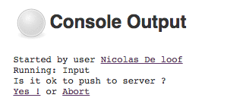
Human interaction
DSL keyword for interactive step
input
message: 'Is it ok to deploy ?',
ok: 'Yes!',
submitter: 'boss'
Button caption
Role restriction
Notes:
Input is the command for interaction, then specify what you want to have user do i.e. approve something.

Slide 42
Lab # – Interact With Humans
Goal:
The aim of this Lab is to
add a manual step to the
Workflow, for confirmation or
approval
See Lab Exercise Workbook
Lab #.
Input

Slide 43
Key Workflow DSL – parallel execution

Slide 44
execution control
wait for event
waitUntil {
// some block
}
timeout
timeout(time: 100,
unit: 'SECONDS') {
// some block
}
try up to N times
retry(10) {
// some block
}
pause
sleep time: 10,
unit: 'MINUTES'

Slide 45
execution control
You can also rely on Groovy control flow syntax
while(something) {
// do something
if (something_else) {
// do something else
}
}

Slide 46
Concurrency
Workflow can execute tasks in parallel :
parallel
firstBranch: { // do something },
secondBranch: { // do something else }

Slide 47
Key Workflow DSL – stages

Slide 48
Stages
Stages let you label parts of the workflow
stage ‘build'
…
stage ‘test'
…
stage ‘package'
…
stage ‘deploy'
This will be rendered by visualization

Slide 49
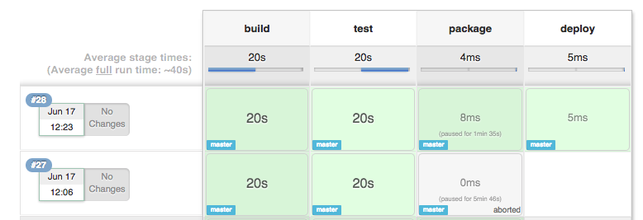
Workflow Stage View
Notes:
Can look at log files to see durations, etcv.

Slide 50
Stages
Stages also let you control concurrency
stage name: 'load-tests',
concurrency: 4,

Slide 51
Workflow Stage View

Slide 52
What is Workflow Stage View
When you have complex builds pipelines, it is useful to be able to see the progress of each stage. To that end, Jenkins Enterprise includes an extended visualization of workflow build history on the index page of a flow project, under Stage View. (You can also click on Full Stage View to get a full-screen view.)

Slide 53
Benefits: Simplicity
By adding Stage View to your Workflow jobs it allows users to easily identify the progress of each stage within the job.

Slide 54
Where do we start?
To take advantage of this view, you need to define stages in your flow. You can have as many stages as you like, in a linear sequence. (They may be inside other steps such as node if that is convenient.) Give each a short name that will appear in the GUI.
stage 'Checkout'
node {
svn 'https://svn.mycorp/trunk/'
stage 'Build'
sh 'make all'
stage 'Test'
sh 'make test'
}

Slide 55
Lab Exercise:
Setting Up Workflow Stage View

Slide 56
Lab # – Stages
Goal:
The aim of this Lab is to
simulate a continuous delivery
workflow.
See Lab Exercise Workbook
Lab #.
Stages

Slide 57
Key Workflow DSL – checkpoint

Slide 58
Checkpoints
Complex workflow may fail due to external causes (test resource offline, etc…)
Restarting from step 1 would be a waste of time and resources
Checkpoints capture the workflow state
Allow to start a new execution from intermediate state

Slide 59
Lab # – Checkpoint
Goal:
The aim of this Lab is to
demonstrate the declaration of a
checkpoint in a workflow
See Lab Exercise Workbook
Lab #.
checkpoint

Slide 60
Workflow with Docker Day 3

Slide 61
Key Workflow DSL – execution control

Slide 62
**Need Slides: Execution Control

Slide 63
Lab # – Control flow
Goal:
The aim of this Lab is to
introduce workflow DSL control
flow syntax (based on Groovy).
See Lab Exercise Workbook
Lab #.
Control Flow

Slide 64
Key Workflow DSL – concurrent execution

Slide 65
**Need Slides: Concurrent Execution

Slide 66
Lab # – Control flow
Goal:
The aim of this Lab is to introduce workflow DSL control flow syntax (based on Groovy).
See Lab Exercise Workbook
Lab #.
Control Flow

Slide 67
Workflow with Docker Day 4

Slide 68
Docker

Slide 69
**Need Slides: Docker

Slide 70
Integrating Workflow and Docker

Slide 71
**Need Slides: Integrating Workflow
and Docker

Slide 72
Course Review

